Slide 1

Kubernetes Issue Prediction Model
Team SanjiMu

Slide 2
Kubernetes Issue Prediction Model
Predicts issues in Kubernetes clusters using Machine Learning.
Uses historical issue data to classify potential problems.
Deployed as a REST API for easy integration.

Slide 3
Dataset Overview
Collected data on past Kubernetes issues.
Features include CPU usage, memory usage, pod status, and network latency.
Target variable: Issue Type (e.g., Resource Exhaustion, Pod Crash, Network Failure).

Slide 4
Model Training Process
Used XGBoost Classifier for high accuracy.
Split dataset into 80% training and 20% testing.
Achieved 99.7% accuracy in classification.

Slide 5
Flask API for Predictions
Exposes a /predict endpoint.
Accepts JSON input with Kubernetes metrics.
Returns predicted issue type as a response.

Slide 6
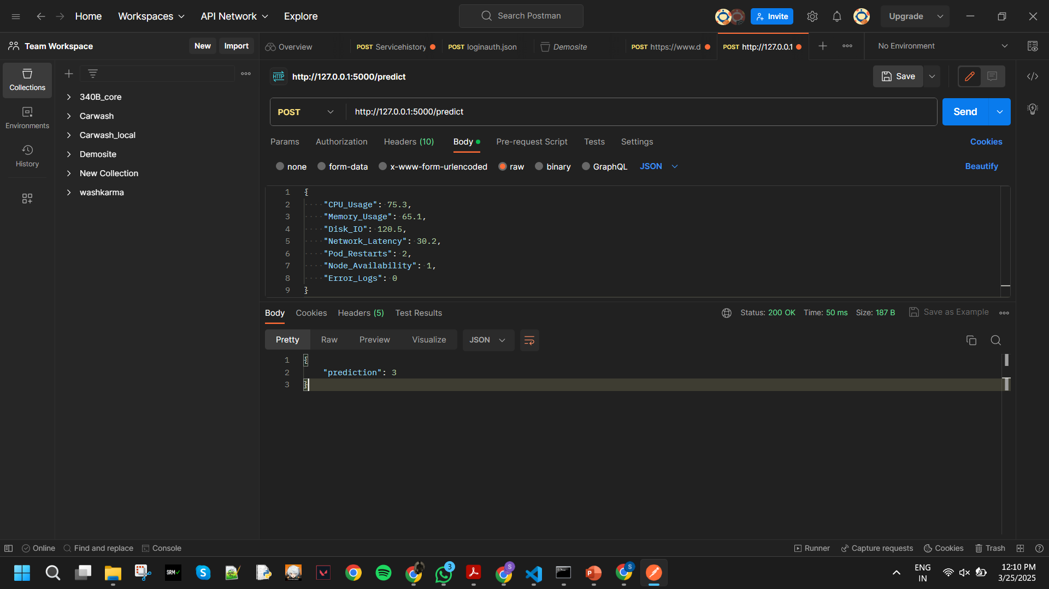
Live API Demo

Slide 7
Next Steps
Improve dataset with more real-world data.
1
Add anomaly detection for unknown issue types.
2
Optimize model for real-time Kubernetes monitoring.
3

Slide 8
Summary & Takeaways
Built a high-accuracy model for Kubernetes issue prediction.
Deployed it as a REST API for easy integration.
Future enhancements include real-time predictions and anomaly detection.

